Slide 1
Georgia Tech Design Methods Project Audience Building
Joy M. Johnson

Slide 2
About GAB
58th Season
24 member Professional Company
The School of The Georgia Ballet
2013 Happenings

Slide 3
Methodology Georgia Tech Project
Three Parts to the Project Observation
Interview
Provide solutions
Initial Interview with Executive Director

Slide 4
Initial Insights From GAB Interview
The Nutcracker is the most attended show by a significant margin due to it being a holiday tradition for many families
Audience members are the most engaged by the skill and dedication of the dancers, however, the intrigue they hold for the dancer’s skills does not necessarily translate into a connection with the dancer or the subject of the show
The line between the company and the school are often blurred in the eyes of the audience
Notes:
Cristina or Minsuk

Slide 5
Typology: Other Ballets in Georgia
 | The Georgia Ballet | Atlanta Ballet | Gwinnett Ballet Theatre | Northeast Atlanta Ballet | Gainesville Ballet | Golden Isles Ballet Company | Ballet Theater South
Ballet School
Company |  |  | Pre- Professional | Pre- Professional | Pre- Professional
Nutcracker |  |  |  |  | N/A
Facebook
Instagram
Twitter
Youtube
Yelp
Notes:
Cristinta

Slide 6
Main Needs
To translate a holiday tradition into a regular activity
Of audience members to be in awe of the seemingly impossible, but still connect to dancers and show’s theme
To differentiate the school and the company, to prevent audience members from viewing the company as students rather than professionals

Slide 7
Interviews Created a survey Non User
Demographics
What are your personal impressions of ballet?
About how many times have you been to a professional ballet performance?
On a scale of 1 - 5, how likely are you to bring your significant other to the ballet for a date night?
What resources do you use to find out about art events happening around you?

Slide 8
Surveys taken at 4 locations
Target
High Museum
Ponce
Ga Tech

Slide 9
Do you Like Ballet?
High Museum 12 out of 14 Y
Target 10 out of 14 Y
Ponce 4 out of 12 Y
Ga Tech 4 out of 12 Y

Slide 10
What kind of Ballet are you interested in Seeing
162 Contemporary/Modern
118 Classical
11 didn’t know

Slide 11
Are you Aware of The Georgia Ballet?
22 out of 52 said yes
Have you ever seen one of their shows?
5 out of 52 said yes
Notes:
Didn’t ask if they were aware of Atlanta Ballet

Slide 12
Where do you look for Arts Activities
Facebook is overwhelmingly the place that people find information on arts activities across age groups

Slide 13
Age Group Responses 18 and Under
5 out of 8 say they have seen 3-5 ballets in their lifetime
½ say they would pay $36-$45 for tickets
2/3 don’t care where the performance is located.

Slide 14
Age Group Responses – 19-25 51% of all responses
Most have seen The Nutcracker at least once.
Acceptable price point $16 - $36
3 venues they go to the most
The Fox, High Museum and Atlanta Ballet

Slide 15
Age Group Responses – 26 - 35
About half have seen The Nutcracker
Preferred price point $16 - $36
Like the Fox or the High and rate location importance as 3 out of 5

Slide 16
Age Group Responses – 36 -45
50% say they have seen 5 or more ballets and 39% say they have seen more than 10
Price Point $26 and up 28% say they would accept any price
The Fox and the High are of great interest with 56% saying they are interested in The Atlanta Ballet
Location was about 50/50

Slide 17
Age Group Responses – 46-55
This age group was divided with people responding they had been to 18+ performances of Ballet and the other half was 0-to 3
Not as much of a pattern on price point, it was all over the place
Most say the Fox is their preferred venue
Likes to stay close to home.

Slide 18
Age Group Responses – 56 - 65
Most have seen the Nutcracker but few have seen more than 3 in their lifetime
Price point was $36 – 45 but a number of people didn’t respond
This age group added The Center for Puppetry Arts as one of their favored venues along with the Fox.
This group identified word of month as a major information source
Location is very important to this group

Slide 19
Age Group Responses – 66+
Either seen Ballet frequently or rarely
Price point is $16 - $35
Like Musicals at the Fox, the Symphony and Atlanta Ballet
Want to be close to home

Slide 20
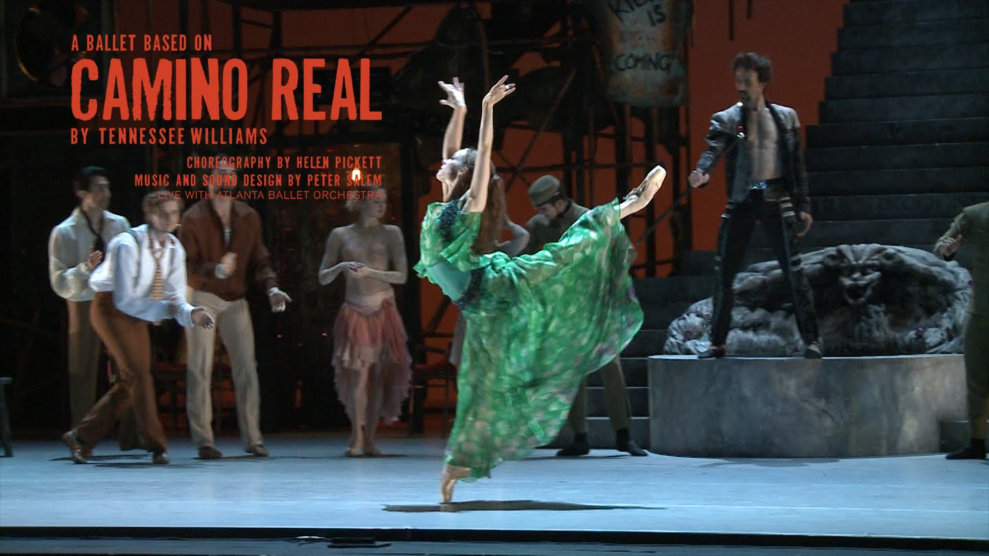
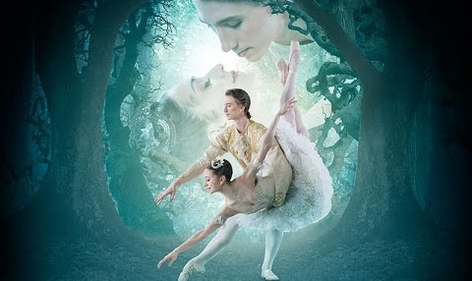
Typology: Trailers
Notes:
Haley
We showed styles of trailers from various companies to non users in order to figure out what style we wanted to recommend to the GB
For the Atlanta Ballet - Camino Real, most people were unfamiliar with the show’s name, and didn’t understand what the plot was about
For the two Georgia Ballet trailers, they received mixed reviews. Some couldn’t tell it was meant for ballet, while others enjoyed the mystery that these trailers gave them.
The Sleeping Beauty trailer from the Royal Opera House was the favorite out of all the trailers, for the non users felt that it showed them what the performance would be like while introducing the story to them.

Slide 21
How might we...
1.use the existing social media structure to properly advertise the ballet? 2. separate/distinguish the school from the company? 3. better advertise to interested audiences? 4. make ballet more interesting to non-users? 5. get men interested in ballet? 6. make ballet seem more exciting and less boring?
Notes:
Haley
We did this in order to brainstorm potential imperatives and insights. It also helped us in brainstorming potential solutions

Slide 22
How might we...
7. utilize the popularity of the Nutcracker to draw a crowd to future performances? 8. use social media to grab new viewers? 9. use other art outlets to advertise for the company? 10. use the other art forms as inspiration and to draw a new type of audience?

Slide 23
AH Haw Moments
We thought we had nailed the differentiation between the school and the company
We had given up on the 36-45 age group but…..
50% say they have seen 5 or more ballets and 39% say they have seen more than 10

Slide 24
Solutions
Notes:
CRISTINAAA

Slide 25
Strategic Seasonal Layout
The most attended show of the season is the Nutcracker
Strategically plan for the next show in the season to have more modern content in order to entice audience members
Notes:
Haley
We did this in order to brainstorm potential imperatives and insights. It also helped us in brainstorming potential solutions

Slide 26
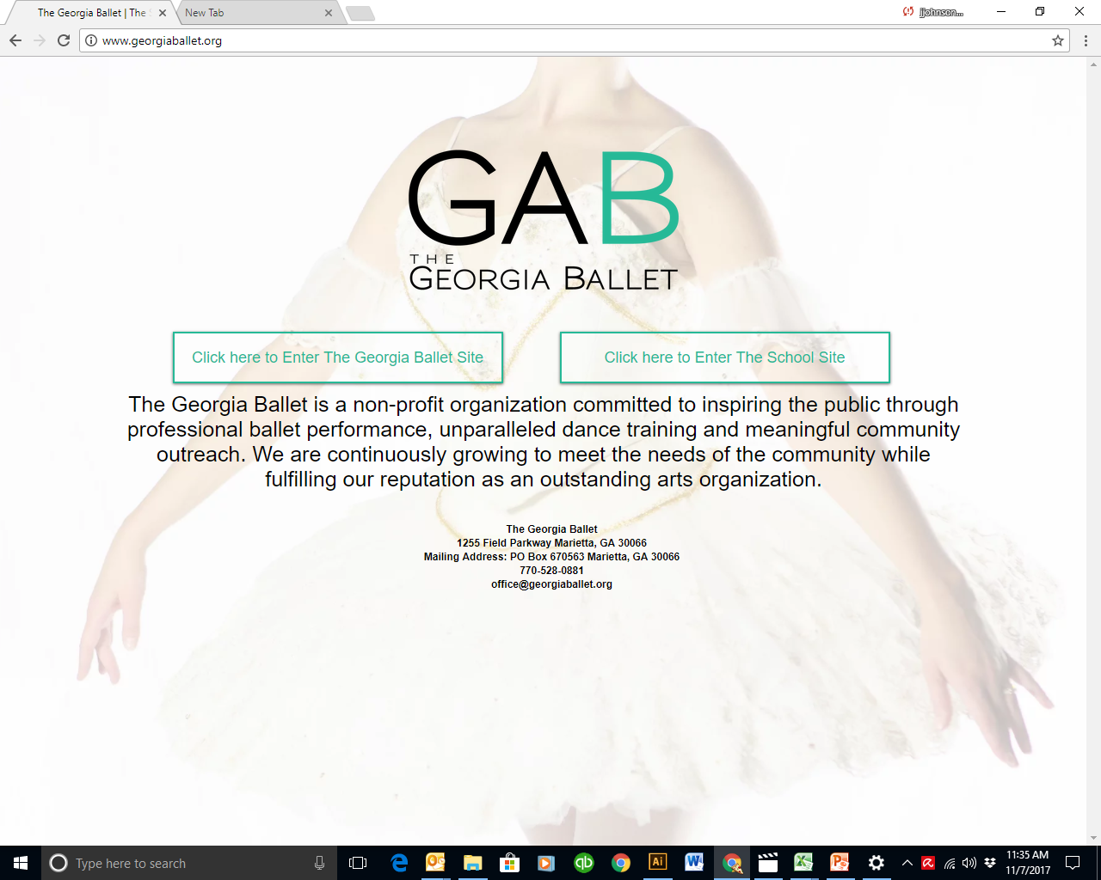
Website
Notes:
JORDANN

Slide 27
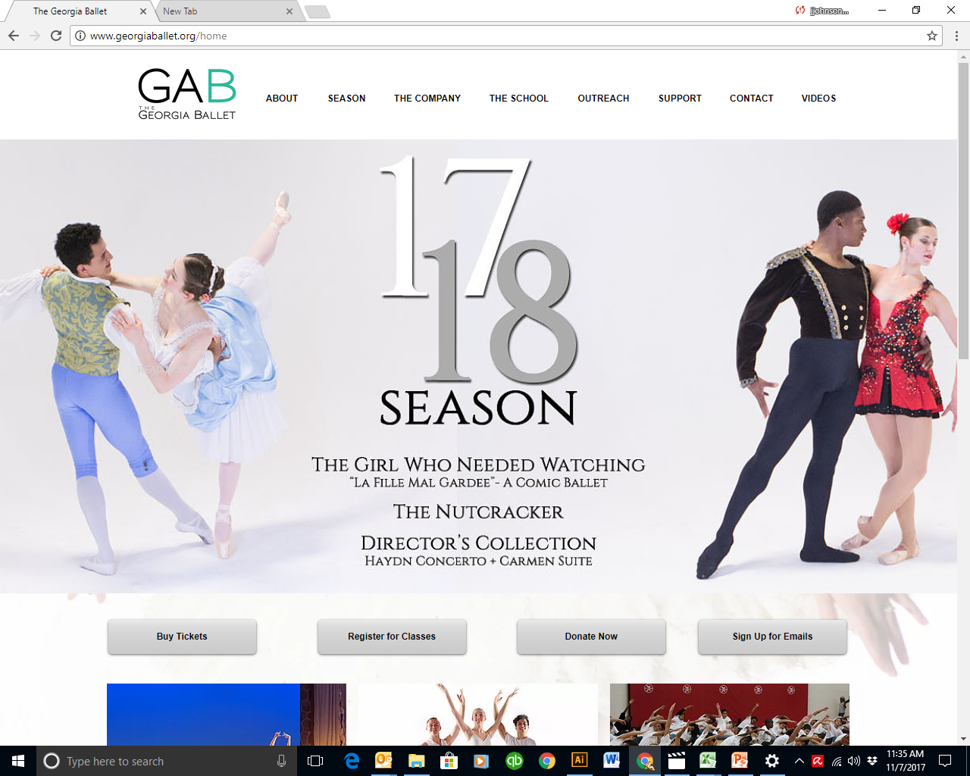
Company

Slide 28
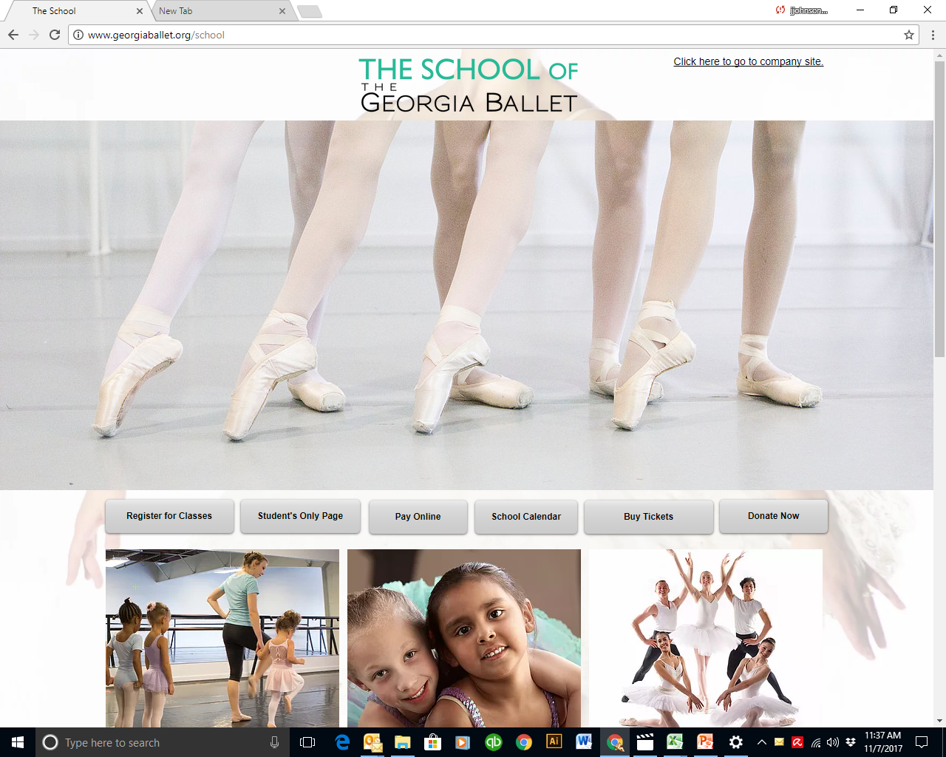
Website

Slide 29
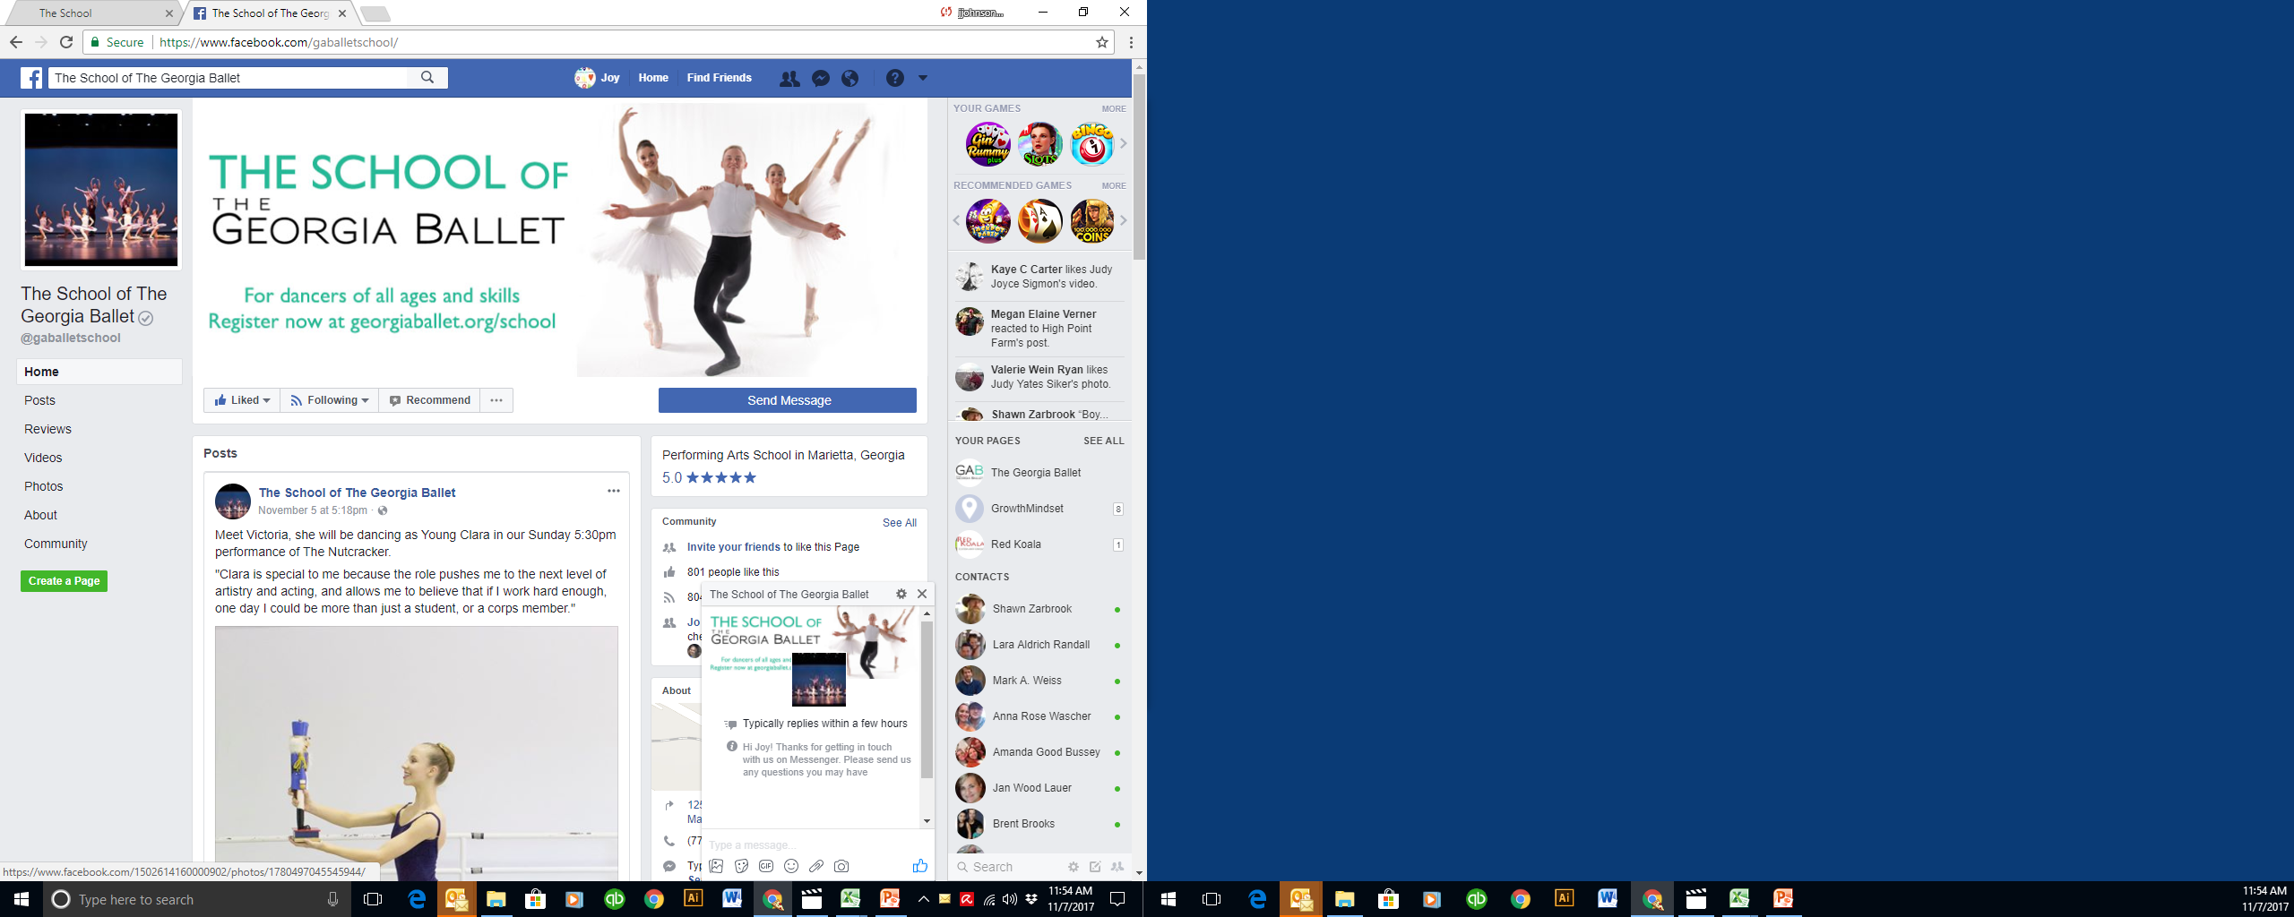
Facebook
Notes:
JORDANN

Slide 30
Thank you and are there any questions

